Slide 1
The Future of Work Retention and Compensation Analysis
Analysis Presented to Steven Williams, CEO of Pepsico NA and
Patrick McLaughlin, CHRO of Frito-Lay
Laura Lazarescou, Data Scientist
SMU MS in Data Science Program

Slide 2
Introduction
Context and Data Overview
Exploratory Data Analysis for Two Models
Model Overview
How was the model developed?
How accurate is the model?
Attrition trends and insights
Conclusion and Recommendations

Slide 3
Context and Data Overview
Frito-Lay seeks to transform its culture and reduce employee turnover. With an evolving demographic and low unemployment rate in North America, it is imperative that Frito-Lay become a “Best Place to Work” in order to manage operating costs and maintain market leadership.
Data Overview – Three (3) datasets
Train dataset – master with all data needed to create (2) models
870 anonymized employee data records
36 factors
Test dataset for Attrition
Test dataset for Salary
DDSAnalytics has developed two models
Attrition: Identify key factors that lead to employee attrition
Salary: Understand the role that salary plays in retaining employees

Slide 4
Exploratory Data Analysis (EDA) Salary and Attrition Models
Rstudio and R compatibility
Converted numeric categorical factors to as.factor
NA grooming – no NAs
Evaluate data compliance with statistical assumptions
Normal distribution
Equal variance
Independence
Outliers, Leverage
Data value analysis
Train: No NA or null values.
Single value factors: Over18, StandardHours, EmployeeCount removed

Slide 5
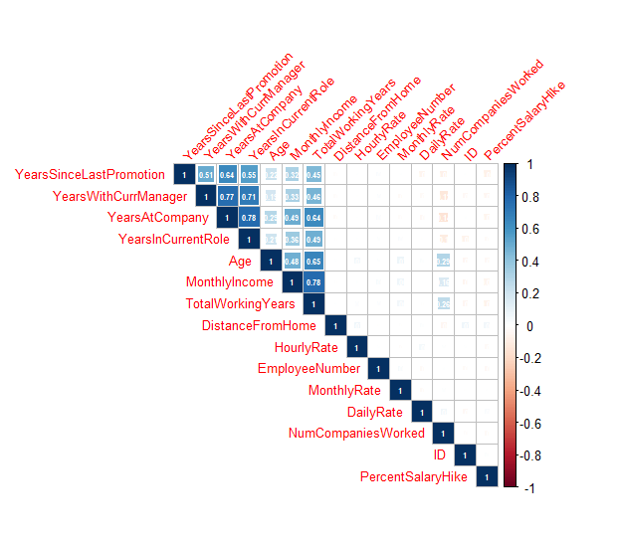
Collinearity: Identify and Reduce Redundant Variables
Few numeric variables are highly correlated.
Alternate selection of
YearsAtCompany
YearsWithCurrentManager
YearsInCurrentRole
TotalWorkingYears

Slide 6
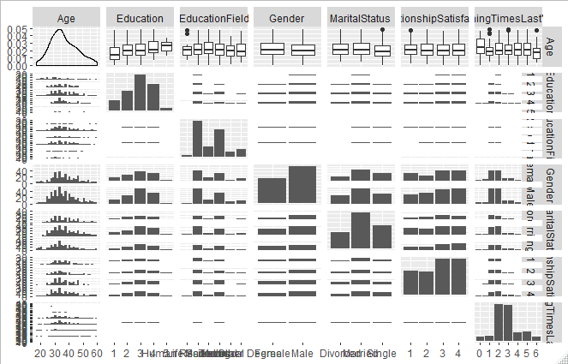
Evaluate Statistical Assumptions People-Focused Variables (1/4)
Normal Distribution
Equal Variance
Independence
Outliers
Leverage
Age
Education
Education Field
Gender
Marital Status
Relationship Satisf.
# of Training Times since last year

Slide 7
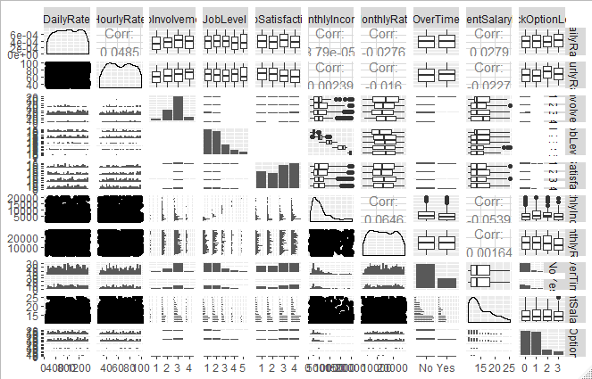
Income-Oriented Variables (2/4)
Daily Rate
Hourly Rate
Job Involvement
Job Level
Job Satisfaction
Monthly Income
Monthly Rate
Overtime
% Salary Hike
Stock Option Level

Slide 8
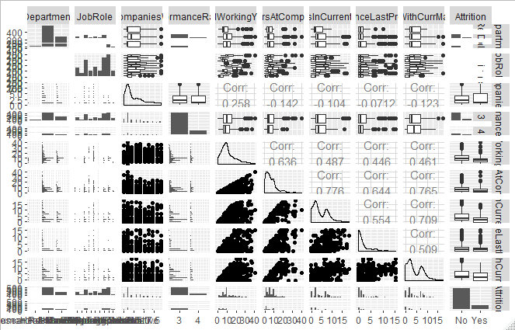
Organizational Variables (3/4)
Department
JobRole
# of Companies
Performance
Total Working Yrs
Years at Company
Years in Role
Years Since Promotion
Years w/Manager

Slide 9
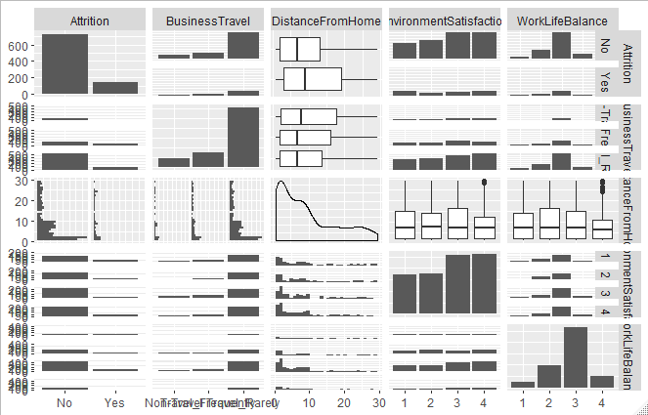
Work-Life Balance Variables
Attrition
Business Travel
Distance from Home
Environmental Satisfaction
Work-Life Balance

Slide 10
Salary Model: Multiple Linear Regression
Forward, Backward, Stepwise approach with full dataset
Iterative approach to maximum number of factors
Top three factors (Frito-Lay request)
Differences in R-squared and CV PRESS ( show table of different values)
Preferred model – Generate Predictions
Predictive accuracy and sensitivity

Slide 11



Salary Regression Analysis
We can model Frito-Lay salaries with 95.3% accuracy using a Custom Linear Regression Model.
Regression Model | # of Variables | R-squared
Forward | 68 | .943
Backward | 61 | .942
Stepwise | 56 | .948
Custom | 20 | .953

Slide 12
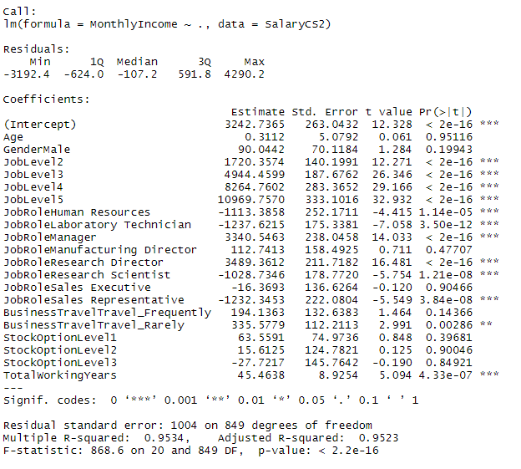
Salary Regression – Top Factors
Strongest Contributors
Job Level
Job Role: Some job roles may be underpaid vs. market.
Business Travel: Surprising relationship. Higher travel has lower pay. Recommend review and compare with Attrition.
Gender: Evaluate on a per-role basis. Other factors held constant, males earn $90 more than females.

Slide 13
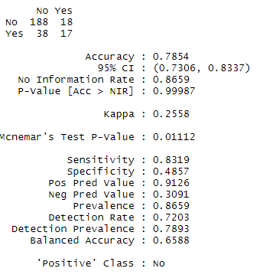
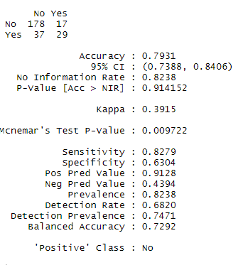
Attrition Model: Classification
Attrition is a Yes/No categorical value. No detail on voluntary or involuntary
16.1% Attrition: 140 employees / 870 Total
Both models are Naïve Bayes formulas
Model 1: 78.5% Accuracy / 83.19% Sensitivity / 48.57% Specificity – 32 variables
Model 2: 79.31% Accuracy / 82.8% Sensitivity / 63.04% Specificity – 14 variables
Age
Department
MonthlyIncome
MaritalStatus
BusinessTravel
DistanceFromHome
EnvironmentSatisfaction
JobInvolvement
JobLevel
OverTime
PerformanceRating
StockOptionLevel
TrainingTimesLastYear
WorkLifeBalance

Slide 14
Conclusions
Data was very clean but extensive and largely categorical.
Reduction in number of variables improved accuracy, sensitivity and specificity
Salary is relatively predictable: 95% accuracy with few variables
Attrition is more evasive
Need clarification if all Attrition was voluntary?
Mean salary for Attrition=Yes is lower than Attrition = No. Consider market-level analysis on salary.
Work-Life Balance is more important to younger workers. Evaluate travel requirements with pay scale. Consider remote work options.
Next Steps: Continue analysis of role-based attrition and potential gender gap.

